Slide 1

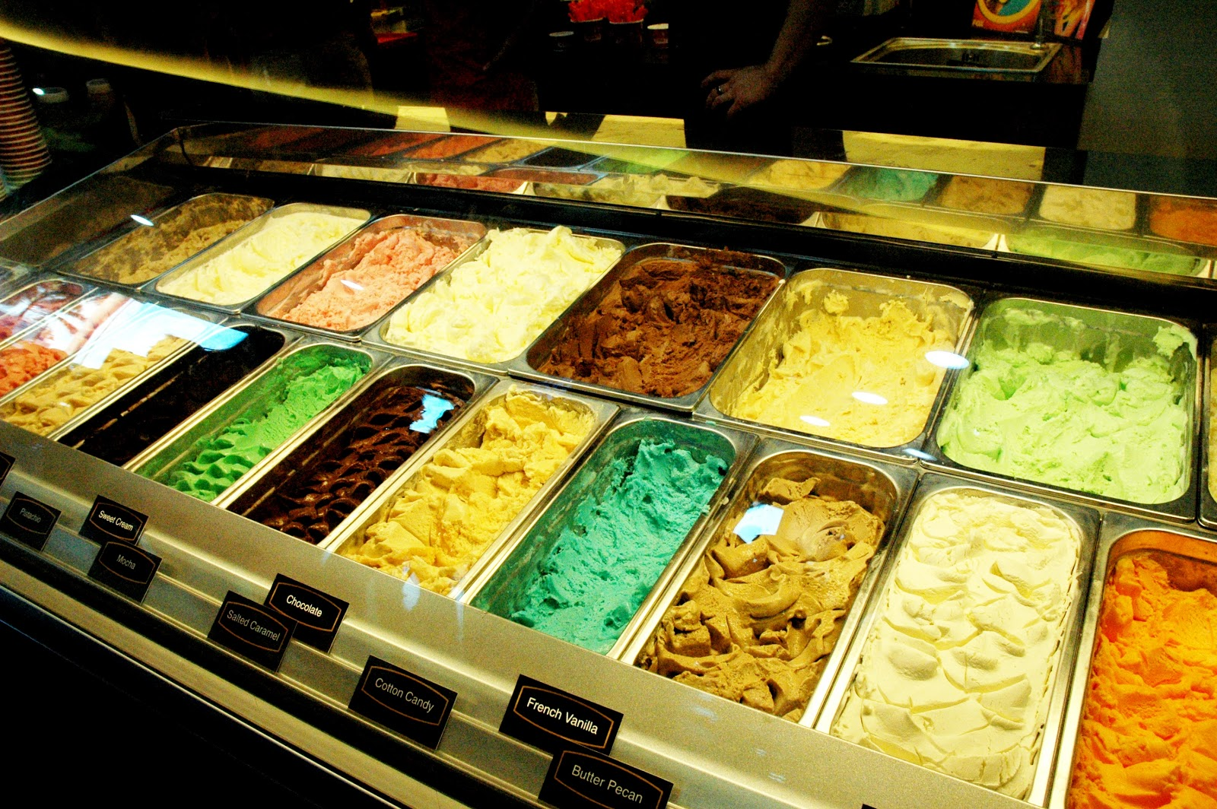
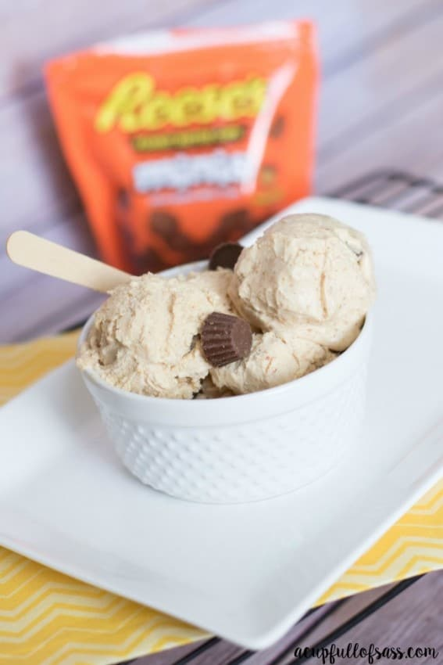
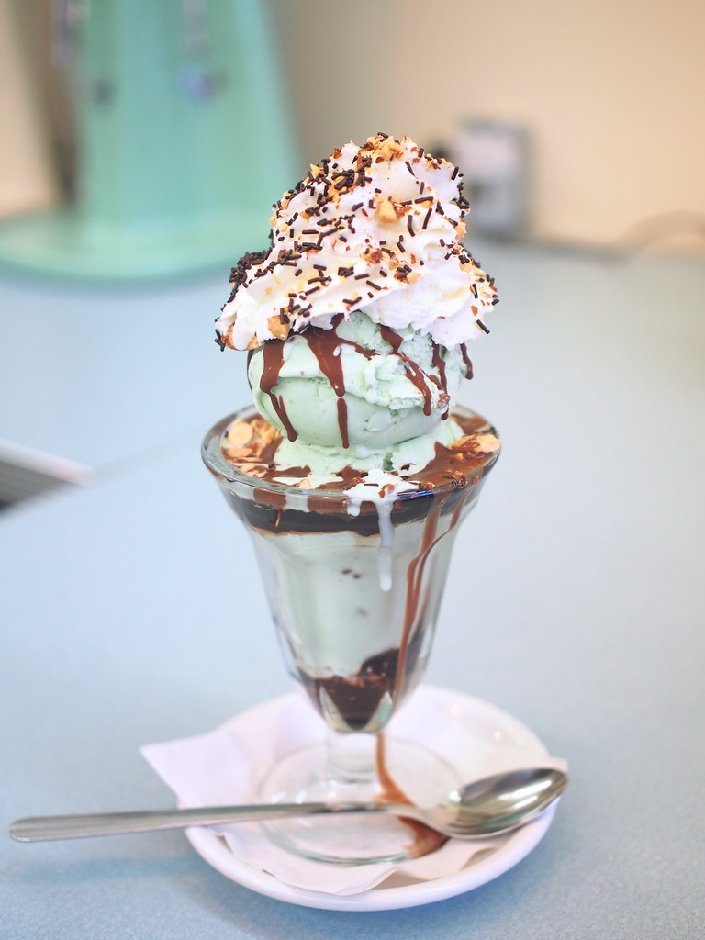
HOME MENU CONTACT US REVIEWS
Specials of the week
Reese’s Double Peanut Butter Ice Cream
Mint Chocolate Chip Sundae
608 Main Street Everest, KS 66424 Call: 785-758-4861
This Photo by Unknown Author is licensed under CC BY-ND

Slide 2
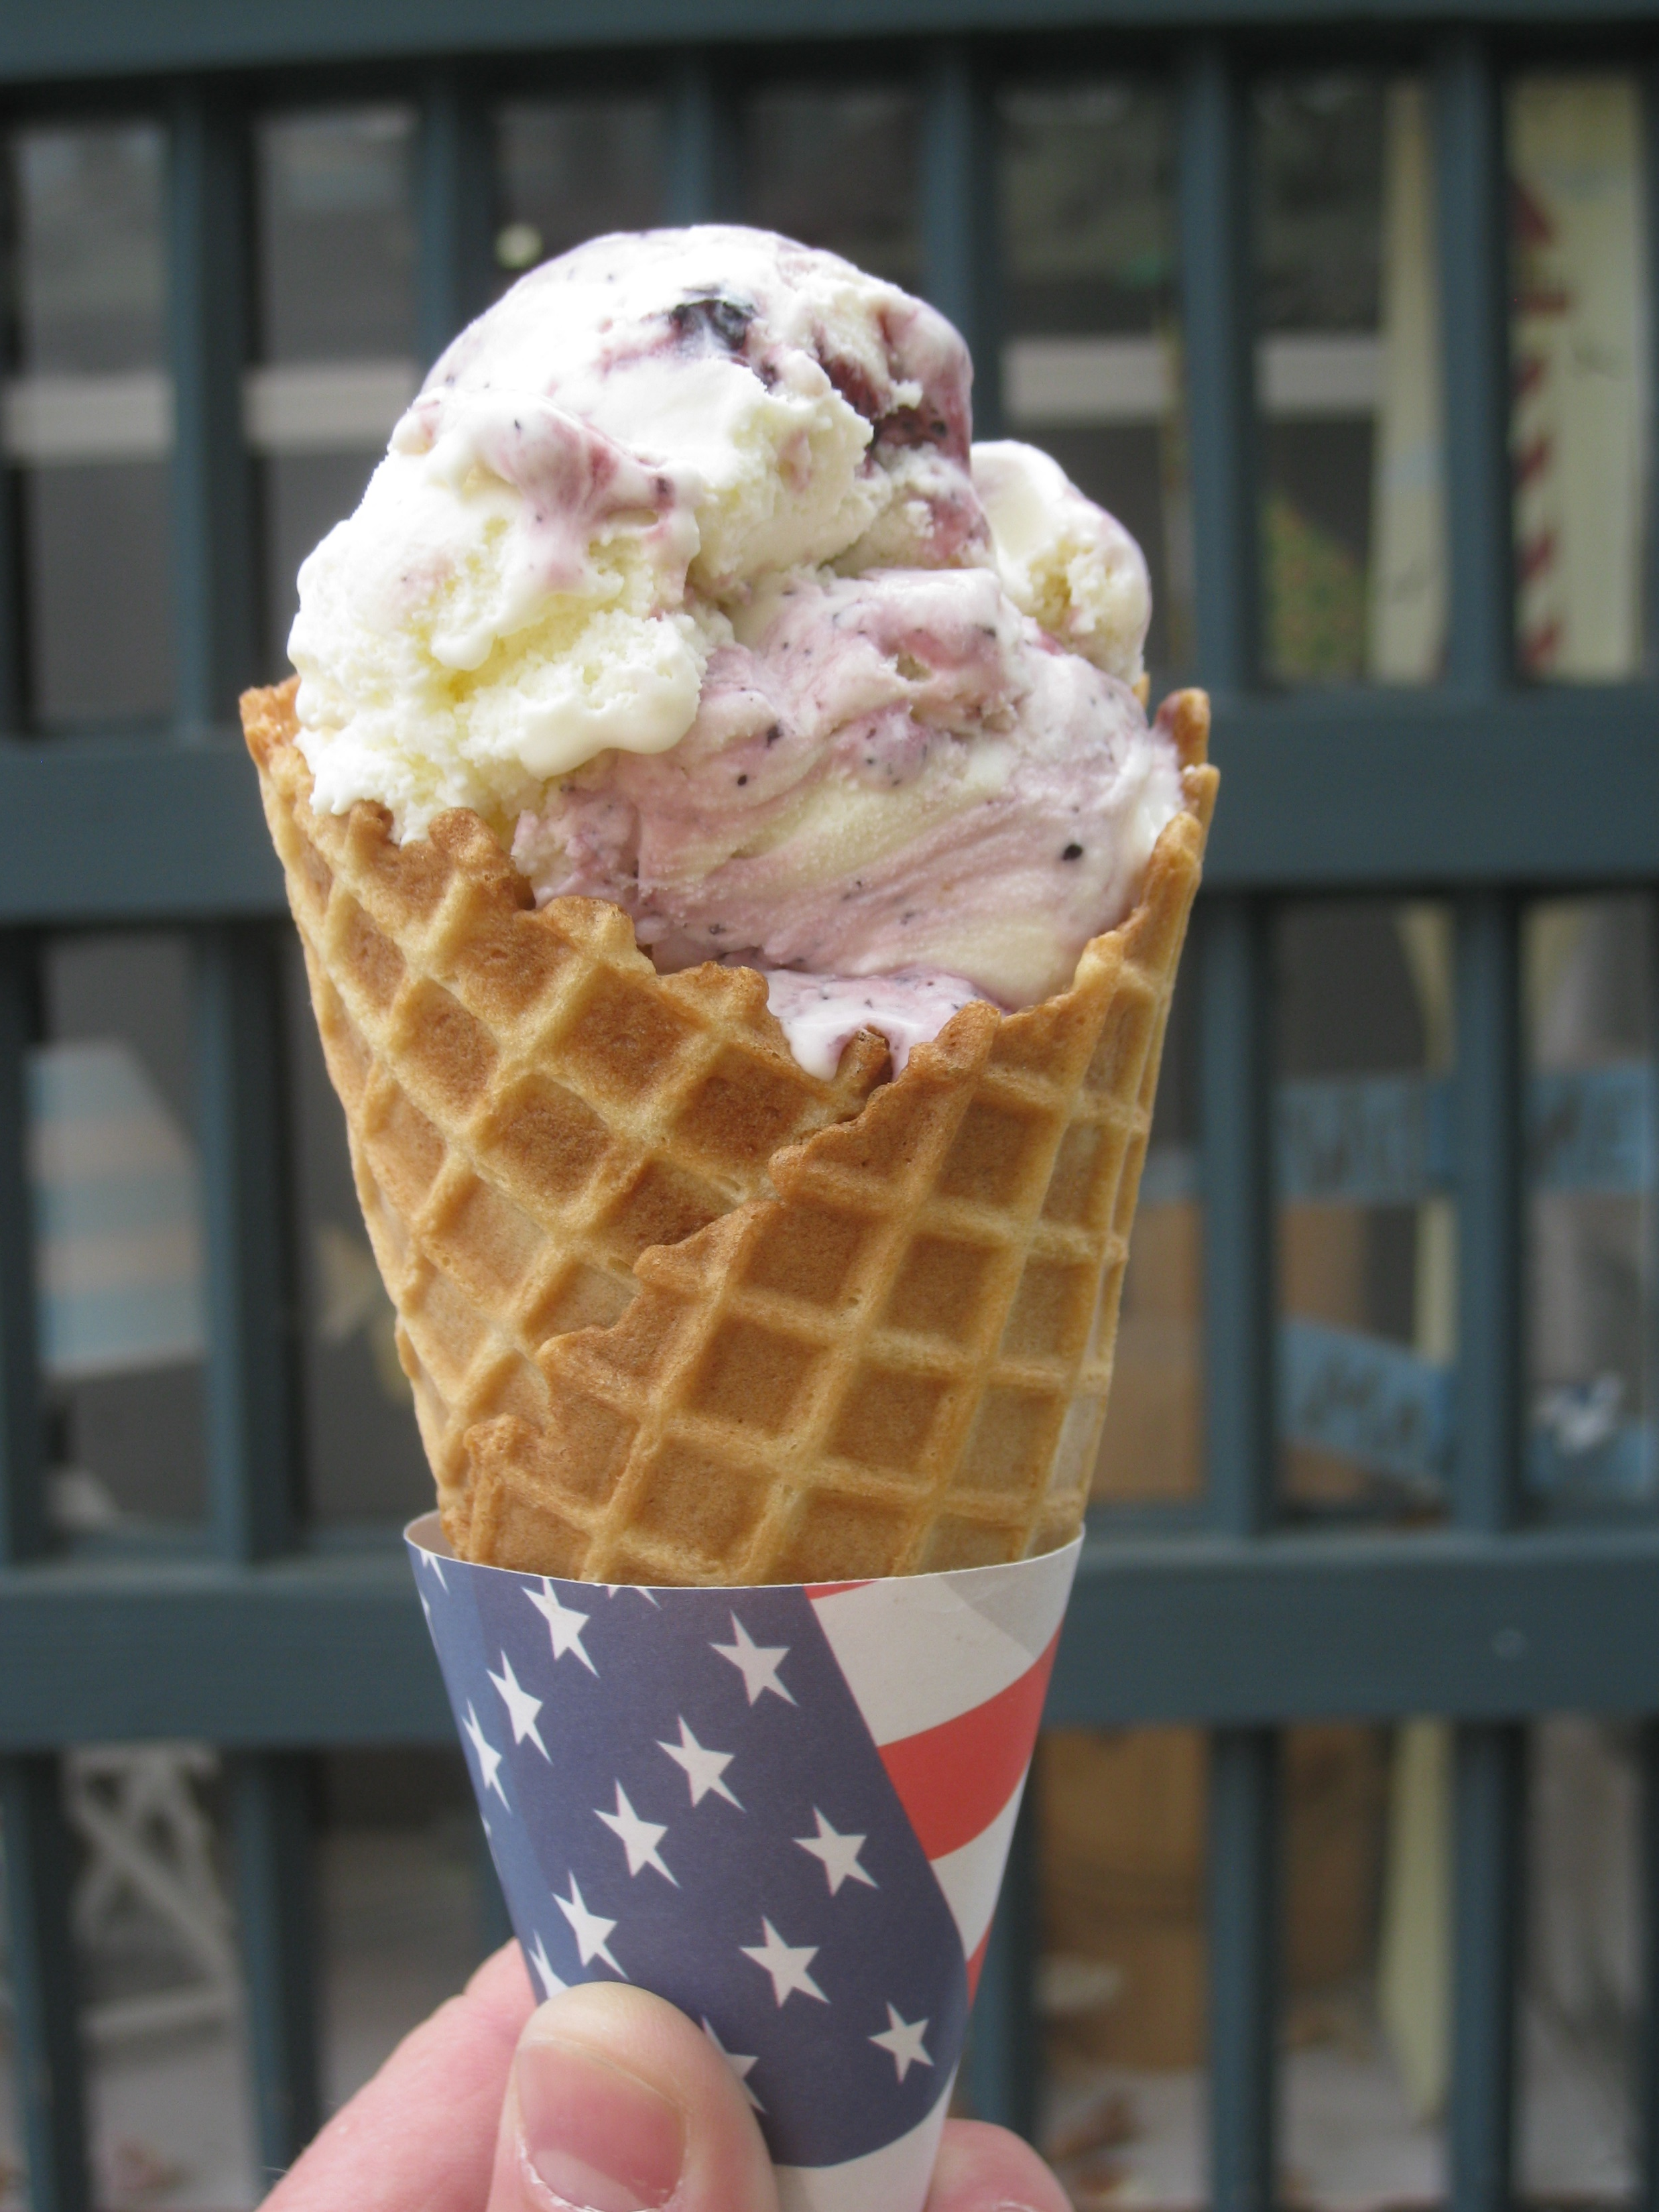
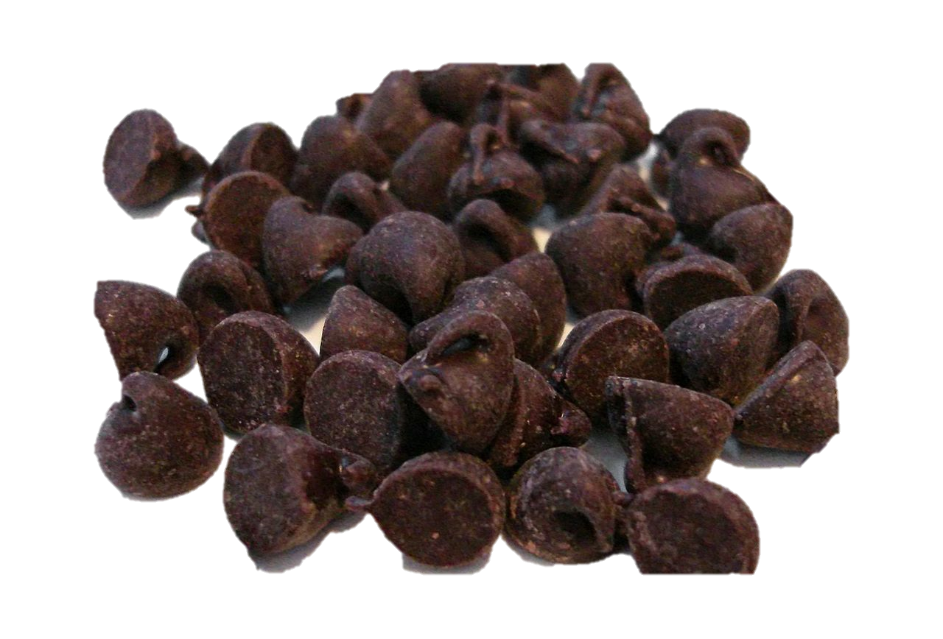
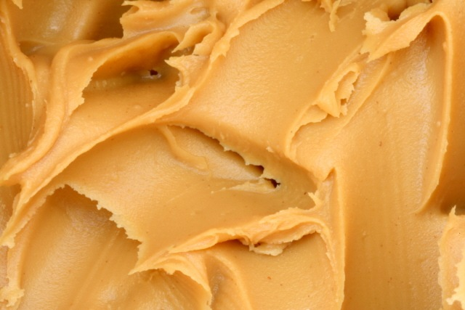
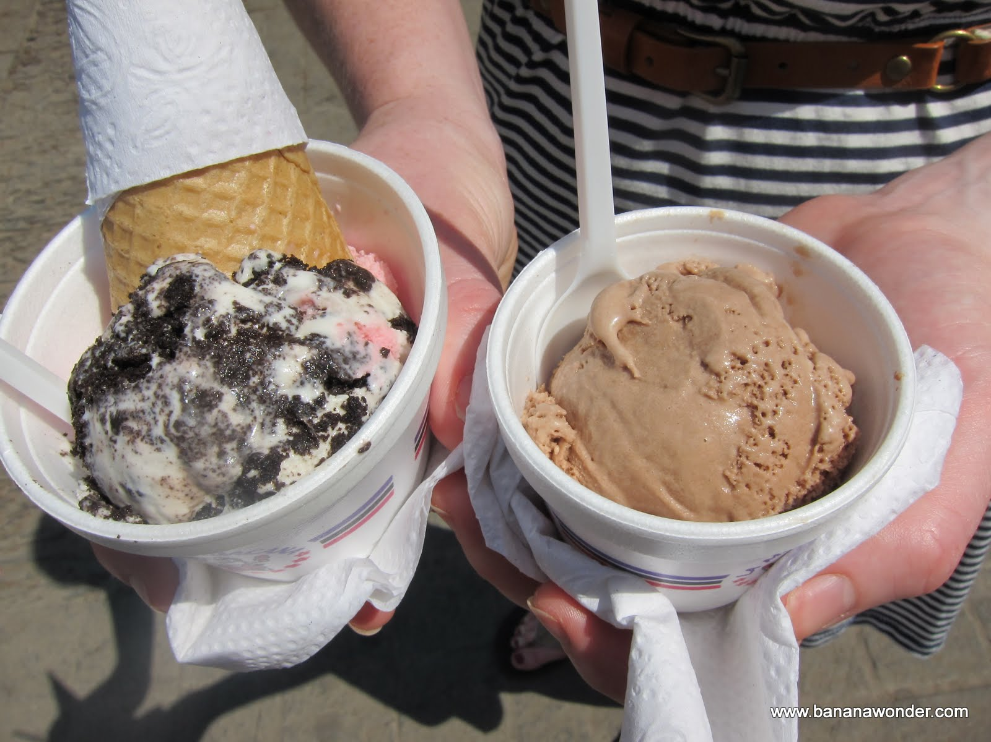
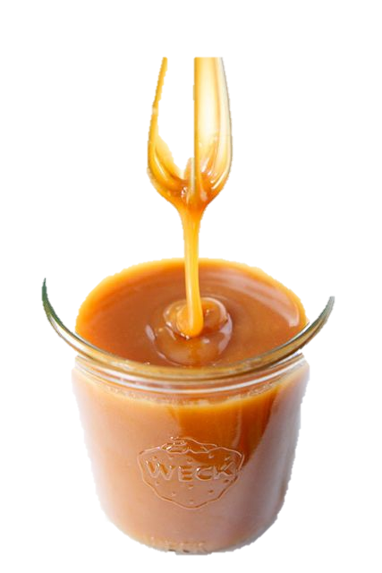
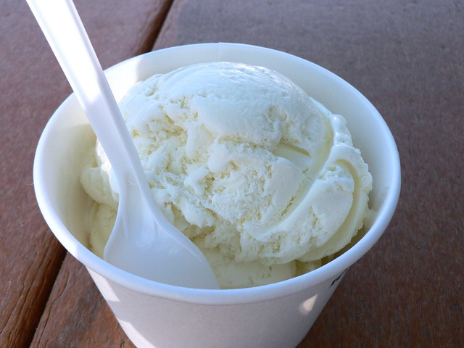
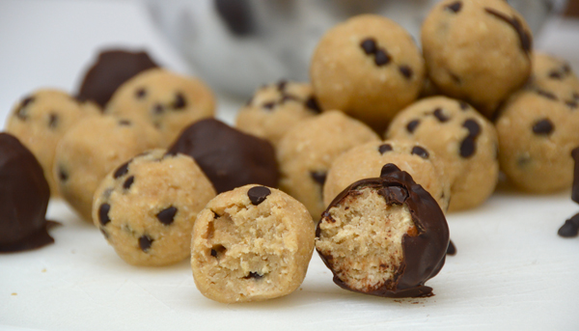
MENU
HOME MENU CONTACT US REVIEWS
1 scoop: $3.00 2 scoops: $4.00 3 scoops: $4.50
Flavors:
Vanilla
Chocolate
Strawberry
Mint Chocolate Chip
Rocky Road
Cheesecake
Peanut Butter
Bubble Gum
Oreo
Sugar Cones
Waffle Cones
Bowls
Extras :
Hot fudge
Carmel
Peanut butter
Strawberry
Toppings :
Chocolate chips
Sprinkles
Granola
M&Ms
Roasted nuts
Health
Oreo
Cookie dough
608 Main Street Everest, KS 66424 Call: 785-758-4861
This Photo by Unknown Author is licensed under CC BY-SA-NC

Slide 3
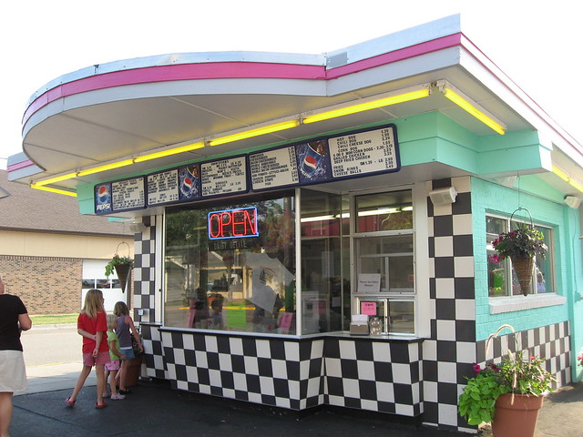
CONTACT US
HOME MENU CONTACT US REVIEWS
Hours:
Sunday: closed
Monday-Saturday:
1:00 p.m.- 9:00 p.m.
Name:
Number:
Email:
Comments:
608 Main Street Everest, KS 66424 Call: 785-758-4861

Slide 4
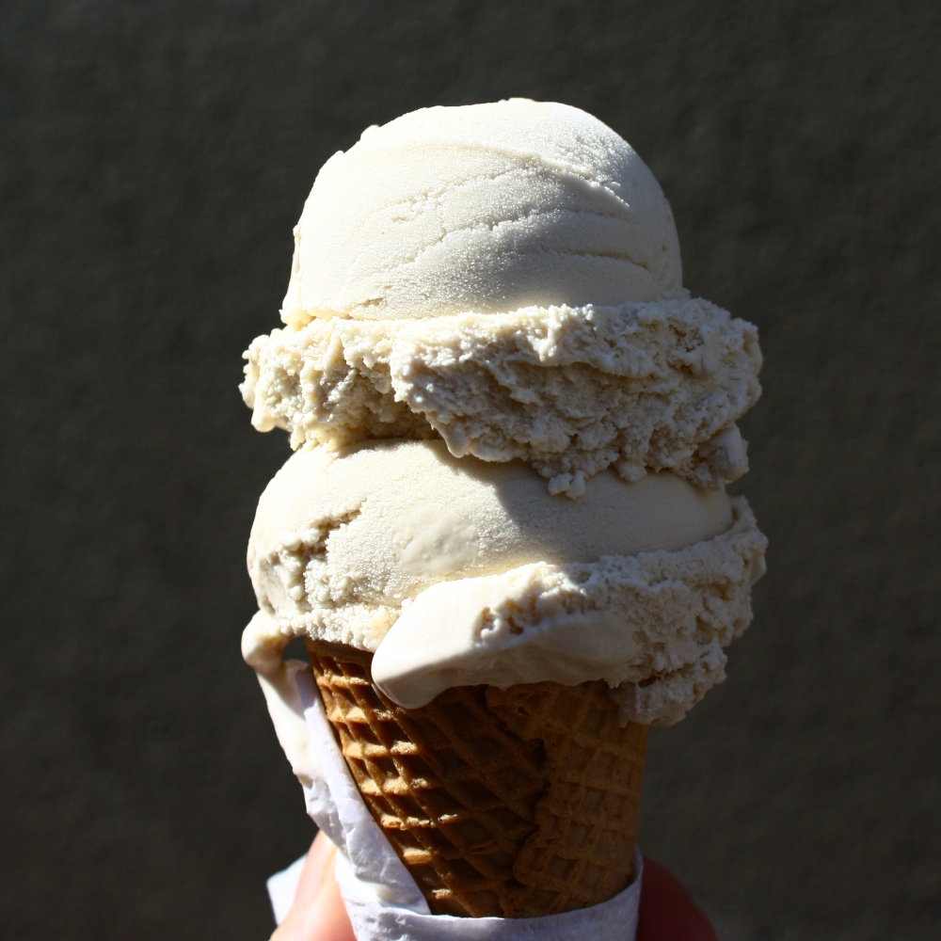
REVIEWS
HOME MENU CONTACT US REVIEWS
Review 1
Review 2
608 Main Street Everest, KS 66424 Call: 785-758-4861

